Slide 1
Chapter 5
Time Value of Money 2: Analyzing Annuity Cash Flows
Finance 6th Edition
Cornett, Adair, and Nofsinger
© McGraw Hill LLC. All rights reserved. No reproduction or distribution without the prior written consent of McGraw Hill LLC.

Slide 2
Learning Goals
Compound multiple cash flows to the future.
Compute the future value of frequent, level cash flows.
Discount multiple cash flows to the present.
Compute the present value of an annuity.
Figure cash flows and present value of a perpetuity.
Adjust values for beginning-of-period annuity payments.
Explain the impact of compound frequency and the difference between the annual percentage rate and the effective annual rate.
Compute the interest rate of annuity payments.
Compute payments and amortization schedules for car and mortgage loans.
Calculate the number of payments on a loan.

Slide 3
Introduction
Time value of money (T V M).
In the previous chapter, we discussed the process of moving a single cash flow from one point in time to another.
Most scenarios facing businesses feature multiple cash flows, requiring a bit more complicated analysis.
This chapter continues the T V M topic for applications that require many equal payments over time.

Slide 4
Future Value of Multiple Cash Flows
Many scenarios arise in which people may set aside money (or, make contributions to their savings accounts) over time.
E.g., saving for a down payment on a house.
The future value of each of these contributions can be added together to determine worth at some future point in time.

Slide 5
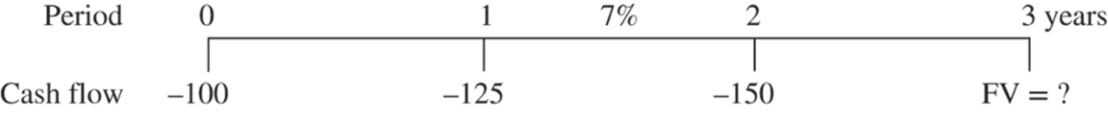
Finding FV – Several Cash Flows Example
Assume you make a $100 deposit today, followed by a $125 deposit next year, and a $150 deposit at the end of the second year. If interest rates are 7 percent, what’s the F V of your deposits at the end of the third year?
Access the text alternative for slide images.

Slide 6
General Equation
The general equation for computing the future value of multiple and varying cash flows (or payments) is:

Slide 7
Future Value – Level Cash Flows
An annuity is a stream of level and frequent cash flows paid at the end of each time period.
Often referred to as an ordinary annuity.
Notes:
In other words, the cash flow is the same and occurs every year.

Slide 8
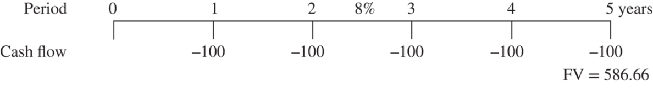
Finding FV – Level Cash Flows Example
Suppose you deposit $100 at the end of each year for five years. If interest rates are 8 percent per year, what is the future value of this annuity stream?
Access the text alternative for slide images.

Slide 9
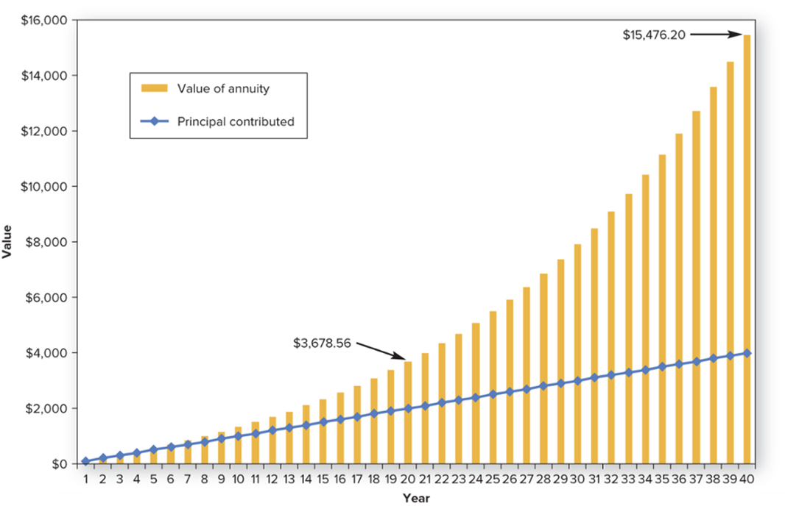
Future Value of a $100 Annuity at 6 Percent
Longer time periods lead to more total compounding and much more wealth.
Access the text alternative for slide images.

Slide 10
Future Value – Multiple Annuities
How can we use the annuity equation to compute the future value when we have two levels of cash flows?
Cash flow can be categorized as two annuities.
Reconsider the annual $100 deposits made for five years at 8 percent per year. This time, the deposit can be increased to $150 for the fourth and fifth years.
First annuity is $100 cash flow for five years and second annuity is $50 cash flow for two years.

Slide 11
Finding F V – Multiple Annuities Example
To find the value of the two annuities, compute the future value of each one separately, and then add them together.
F V of $100 annuity is $586.66, as calculated previously.
F V of $50 annuity is:
F V of both annuities is calculated as:
$690.66 = $586.66 + $104

Slide 12
Present Value of Multiple Cash Flows
The F V concept is useful to understand how to build wealth for the future.
The P V concept will help most particularly for personal applications, such as evaluating loans (e.g., car and mortgage loans), and business applications (e.g., determining the value of business opportunities).

Slide 13
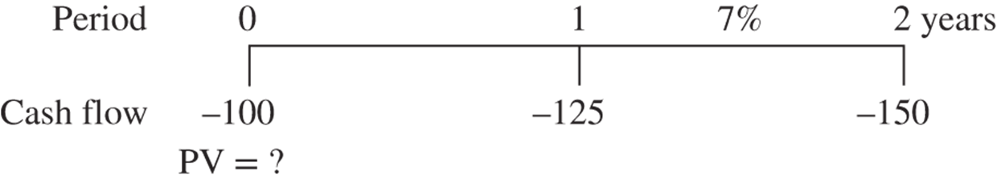
Finding PV – Several Cash Flows Example 1
You deposit $100 today, followed by a $125 deposit next year, and a $150 deposit at the end of the second year, and interest rates are 7 percent.
What is the P V?
Access the text alternative for slide images.

Slide 14
Finding P V – Several Cash Flows Example 2
You deposit $100 today, followed by a $125 deposit next year, and a $150 deposit at the end of the second year, and interest rates are 7 percent.
What is the P V?

Slide 15
General Equation for Discounting Multiple and Varying Cash Flows
The general equation for discounting multiple and varying cash flows is:

Slide 16
Present Value – Level Cash Flows
Most loans are set up so that the amount borrowed (the present value) is repaid through level payments made every period (the annuity).
Each cash flow is the same, and the borrower pays the cash flow every period.

Slide 17
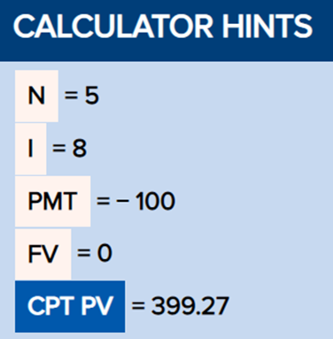
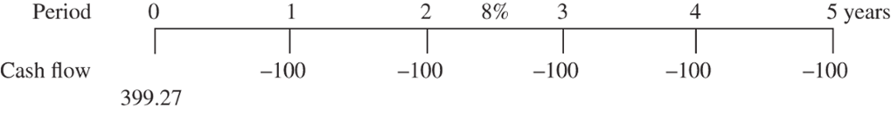
Finding PV – Level Cash Flows Example
Suppose someone makes $100 payments at the end of each year for five years. If interest rates are 8% per year, what is the P V of this annuity stream?
Access the text alternative for slide images.

Slide 18
Present Value – Multiple Annuities
We can combine annuities to solve some P V problems with changing cash flows.
Example (David Price’s M L B contract).
$30 million per year from 2016 to 2018.
$31 million per year in 2019.
$32 million per year in 2020 to 2022.
Using a 5 percent discount rate, what is the present value of Price’s contract?

Slide 19
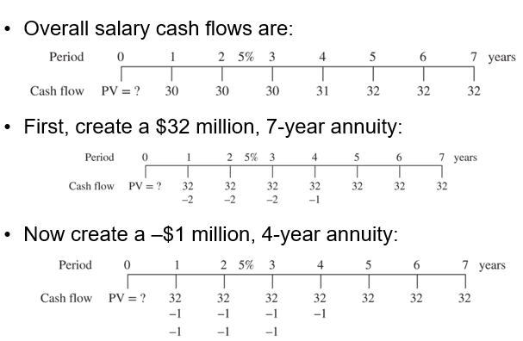
PV – Multiple Annuities Example 1
Access the text alternative for slide images.
Notes:
Notice that creating the –$1 million annuity also resulted in the third annuity of –$1 million for three years. This time line shows three annuities. If you add the cash flows in any year, the sum is Price’s salary for that year.

Slide 20
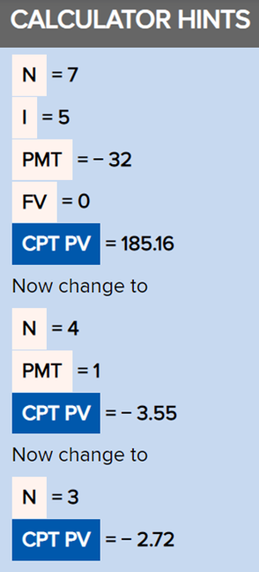
PV – Multiple Annuities Example 2
Adding the value of the three annuities reveals that the P V of Price’s salary was $178.89 m (= $185.16m − $3.55m − $2.72m).
Access the text alternative for slide images.

Slide 21
Perpetuity – A Special Annuity
A perpetuity is an annuity with cash flows that continue forever.
Preferred stocks are an example of perpetuities.
Value of investment is present value of all future annuity payments.

Slide 22
Ordinary Annuity vs. Annuity Due
Ordinary Annuity
An annuity in which cash flows occur at the end of every time period.
Annuity Due
An annuity in which cash flows occur at the beginning of each time period.

Slide 23
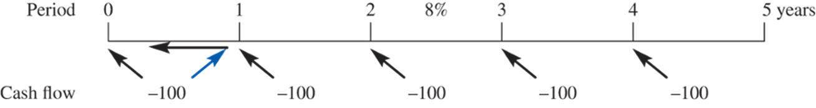
Annuity Due Time Line Example
Consider the five-year $100 annuity due:
Cash flow in the beginning of year 1 looks like it’s actually a cash flow today.
Five annuity-due cash flows are essentially the same as a payment today and a 4-year ordinary annuity.
Payments occur one period sooner than ordinary annuity – earn extra period of interest.
Access the text alternative for slide images.

Slide 24
Future Value of Annuity Due
The future value of an annuity due will simply be the future value of the ordinary annuity multiplied by (1+i).
Earlier in the chapter, the F V of a five-year ordinary annuity was shown to be $586.66.
F V of annuity due is $633.59 (= $586.66×1.08).

Slide 25
Present Value of Annuity Due
The present value of the annuity due is simply the present value of the ordinary annuity multiplied by (1+i).
Earlier in the chapter, we discovered that the present value of a five-year ordinary annuity was $399.27.
P V of annuity due is $431.21 (= $399.27×1.08).

Slide 26
Compounding Frequency
Many situations that use cash flow time-value-of-money analysis require more frequent or less frequent time periods than simple yearly entries.
Semiannual bond payments.
Quarterly stock dividends.
Monthly payments on consumer loans.

Slide 27
Effect of Compounding Frequency 1
Consider a $100 deposit made today with a 12% annual interest rate.
What is the F V of this deposit in one year using various compounding frequencies?
 | A | B | C | D
1 | Frequency | Period Interest Rate | Future Value Equation | Future Value
2 | Annual | 12% |  | $112.00
3 | Semiannual | 6 |  | 112.36
4 | Quarterly | 3 |  | 112.55
5 | Monthly | 1 |  | 112.68
6 | Daily | 0.032877 |  | 112.748
7 | Hourly | 0.00136986 |  | 112.749

Slide 28
Effect of Compounding Frequency 2
Two important points are highlighted in the table on the previous slide:
The higher the compound frequency, the higher the future value will be.
The relative increase in value from increasing compounding frequency seems to diminish with increasing frequencies.

Slide 29
E A Rs and A P Rs
The interest rate per period times the number of period in a year is the annual percentage rate (A P R).
The effective annual rate (E A R) is a more accurate measurement of what you will actually pay, as it reflects annualizing with compounding figured in.
Relationship between A P R and E A R:

Slide 30
E A R vs. A P R Example
Suppose you borrow $100 today at a 12% interest rate.
A P R: Loan compounds annually – you pay 12.00%
E A R: Loan compounds monthly – you pay 12.68%

Slide 31
Keep Variables Consistent
When computing T V M problems that use intra-year compounding (monthly, quarterly, etc.), be sure to keep all the variables consistent to that compounding:
Monthly loan:
N is months.
I/Y is monthly interest rate (A P R divided by 12).
P M T is monthly payment.

Slide 32
Example 5-5: Car Loan Debt 1
Car Loan Debt
Now you would like to buy a car. You have reviewed your budget and determined that you can afford to pay $500 per month as a car payment. How much can you borrow if interest rates are 9 percent and you pay the loan over four years? How much could you borrow if you agree to pay for six years instead?
Solution:
The loan amount is the present value of the 48-month, $500 annuity. Note that the loan term will be 48 (= 4 x 12) months and the interest rate is 0.75 (= 9 ÷ 12) percent. Using equation 5-4, you discover that you can borrow up to $20,092 to buy a car:

Slide 33
Example 5-5: Car Loan Debt 2
If you are willing to borrow money for six years instead of four, the small change to the equation results in your ability to borrow $27,738. Although this would allow you to buy a more expensive car, it would also require two more years of $500 payments (an additional $12,000 of payments!).

Slide 34
Example 5-6: Making Monthly Pension Contributions
Making Monthly Pension Contributions
Reexamine your original plan to contribute to your company retirement plan. Instead of a total contribution of $4,500 per year for 40 years, you are able to contribute monthly. Given your expected 7 percent per year investment return, how much money can you expect in your retirement account?
Solution:
Now your total monthly contribution will be $375 (= $4,500 ÷ 12), which will continue for 480 months and earn a 0.58333 (= 7 ÷ 12) percent monthly return. The results of equation 5-2 show that the future value of this annuity is

Slide 35
Annuity Loans
In many cases, future and present values of annuities are already known and we need to compare the payments or implied interest rate.
No general, easy equation to solve for the interest rate, even when given the cost of an investment, the annuity cash flows, and the time period.

Slide 36
Finding Payments on Amortized Loan
An amortized loan is characterized by a borrower paying both interest and principal over time.
Rearrange P V of annuity formula to solve for the payment:

Slide 37
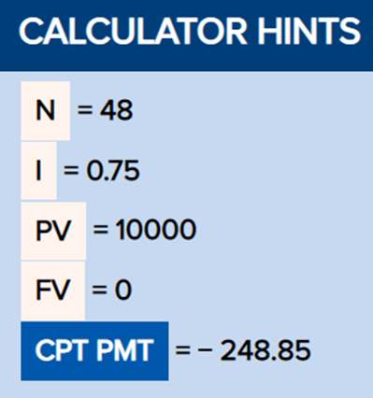
Finding Payments on Amortized Loan Example
Assume you need a $10,000 loan to buy a car.
Loan is for four years, and interest rates are 9 percent per year A P R.
Use an interest rate of 0.75 percent (= 9/12) and 48 periods (= 4×12):
Notes:
So, when interest rates are 9 percent, it takes monthly payments of $248.85 to pay off a $10,000 loan in four years.

Slide 38
Amortized Loan Schedules
An amortization schedule is a table detailing the periodic loan payment, interest payment, and debt balance over the life of the loan.
Loan principal is the balance yet to be paid on a loan.
An interest-only loan allows the borrower to make payments that consist totally of interest payments, so none of the debt is reduced.

Slide 39
Example 5-9: Monthly Mortgage Payments 1
Monthly Mortgage Payments
Say that you have your heart set on purchasing a beautiful, old Tudor–style house for $250,000. A mortgage broker says that you can qualify for a mortgage for 80 percent (or $200,000) of the price. If you get a 15–year mortgage, the interest rate will be 6.1 percent A P R. A 30–year mortgage costs 6.4 percent. One of the factors that will help you decide which mortgage to take is the magnitude of the monthly payments. What will they be?³
Solution:
To pay off the mortgage in only 15 years, the payments would have to be larger than for the 30–year mortgage. The higher payment will be eased somewhat because the interest rate is lower on the 15–year mortgage. The interest rate would be i = 0.061 ÷ 12 = 0.0050833, or 0.50833% per month. The payment for the 15-year mortgage is

Slide 40
Example 5-9: Monthly Mortgage Payments 2
The payment for the 30–year mortgage would be

Slide 41
Compute the Time Period
You might also find it useful to know how long it will take to pay off a loan with specific annuity payments.
Time to Pay Off a Credit Card Balance.
Through poor financial management, your friend has racked up $5,000 in debt on his credit card. The card charges a 19 percent A P R and compounds monthly. His latest bill shows that he must pay a minimum of $150 this month. At this rate, how long will it take your friend to pay off his credit card debt?
Solution:
Using the financial calculator, input I = 1.58333 (= 19/12), P V = 5000, P M T = −150, F V = 0. The answer is 48 months, or 4 years. If the friend pays the minimum payment, then it will be a long time before he will be out of debt. The credit card company is very content to continue to earn the high return for many years–essentially, the interest on the loan and a very small portion of the principal. Your friend should pay more than the minimum charge to reduce his debt quicker.

Slide 42
Add-On Interest
Add-on interest is a calculation of the amount of interest determined at the beginning of the loan and then added to the principal.
Popular in payday lending.
Consider a $1,000 loan to be paid with 9% add-on interest and repaid in 6 monthly payments.
Total interest for this loan is computed as 9% of $1,000 for
six months, or $45
This is added to the principal for a total of $1,045.
Each of the payments is then

Slide 43
End of Main Content
© McGraw Hill LLC. All rights reserved. No reproduction or distribution without the prior written consent of McGraw Hill LLC.

Slide 44
Accessibility Content: Text Alternatives for Images

Slide 45
Finding FV – Several Cash Flows Example – Text Alternative
Return to parent-slide containing images.
On the time line are period from 0 to 3 years from left to right, then cash flow made: 0, negative 100; 1, negative 125; 2, negative 150; and F V is unknown on the third year. The time line shows the deposits and future value of an annuity with 7 percent interest rate.
Return to parent-slide containing images.

Slide 46
Finding FV – Level Cash Flows Example – Text Alternative
Return to parent-slide containing images.
On the time line are period from 0 to 5 years from left to right, then cash flow made minus 100 each year, and F V equal to 586.66 is on the fifth year. The time line shows the deposits and future value of an annuity with 8 percent interest rate.
Return to parent-slide containing images.

Slide 47
Future Value of a $100 Annuity at 6 Percent – Text Alternative
Return to parent-slide containing images.
On the x-axis are years, 1 to 40; on the y-axis is value, 0 to $16,000 in increments of $2,000. The line is the principal contributed, and increases at a steady rate of $100 per year. The bar graph represents the value of the annuity, which increases more quickly than the line. Values given are (20, $3,678.56) and (40, $15,476.20).
Return to parent-slide containing images.

Slide 48
Finding PV – Several Cash Flows Example 1 – Text Alternative
Return to parent-slide containing images.
On the time line are period from 0 to 2 years from left to right, then cash flow from minus 100 to minus 150 in increments of negative 25, and P V equal to question mark on the left. The time line shows the calculation of present value of several cash flows at 7 percent interest rate.
Return to parent-slide containing images.

Slide 49
Finding PV – Level Cash Flows Example – Text Alternative
Return to parent-slide containing images.
On the time line are period from 0 to 5 years from left to right, then cash flow is minus 100 each year, and P V equal to 399.27 on the left. The time line shows the present value of cash flow with 8 percent interest rate.
Return to parent-slide containing images.

Slide 50
PV – Multiple Annuities Example 1 – Text Alternative
Return to parent-slide containing images.
There are three time lines. The first time line shows the overall salary cash flows. The time line starts with a period from left to right from 0 to 7 in increments of 1 unit. Below the time line is the cash flow with the following at each time period from left to right: P V = ?; 30; 30; 30; 31; 32; 32; 32. Between the time period of 2 and 3, 5% is entered. The second time line states first create a $32 million, 7-year annuity. The time line starts with a period from left to right from 0 to 7 in increments of 1 unit. Below the time line is the cash flow with the following at each time period from left to right: P V = ?; 32; 32; 32; 32; 32; 32; 32. Below the cash flow row are the following values under the values related to the periods 1 to 4: negative 2; negative 2; negative 2; negative 1. Between the time period of 2 and 3, 5% is entered. The third time line states now create a negative 1 million, 4-year annuity. The time line starts with a period from left to right from 0 to 7 in increments of 1 unit. Below the time line is the cash flow with the following at each time period from left to right: P V = ?; 32; 32; 32; 32; 32; 32; 32. Below the cash flow row are the following values under the values related to the periods 1 to 4: negative 1; negative 1; negative 1; negative 1. The bottom row under the time periods 1 to 3 are as follows: negative 1; negative 1; negative 1. Between the time period of 2 and 3, 5% is entered.
Return to parent-slide containing images.

Slide 51
PV – Multiple Annuities Example 2 – Text Alternative
Return to parent-slide containing images.
Calculator hints button: n = 7; I = 5; PMT = negative 32; F V = 0; C P T, P V = 185.16. Now change to: n = 4; PMT = 1; C P T, P V = negative 3.55. Now change to: n = 3; C P T, P V = negative 2.72.
Return to parent-slide containing images.

Slide 52
Annuity Due Time Line Example – Text Alternative
Return to parent-slide containing images.
On the time line are period from 0 to 5 years with I = 8% and cash flow of minus 100 each year. The five annuity-due cash flows are the same as a payment today and a four-year ordinary annuity.
Return to parent-slide containing images.

